Slide 1



Microsoft Azure Administrator Associate Training (AZ-103)
Module 2

Slide 2
Agenda
Why Azure Table Storage?
Introduction to Microsoft Azure Storage
05
Azure Blob Storage
09
01
06
Why Azure File Storage?
10
What is Azure Table Storage?
02
Benefits of Microsoft Azure Storage
07
What is Azure File Storage?
11
When to use Azure Table Storage?
03
Overview of Storage Account
04
Types of Azure Storage Accounts
08
Benefits of Azure File Storage
12
Azure Table Storage Concepts

Slide 3
Agenda
Why Azure Storage Queues?
What is Azure Storage Explorer?
Azure Table Storage Keys
17
21
13
18
What are Storage Queues?
22
Azure Storage Explorer Use Cases
14
Benefits of Microsoft Azure Storage
19
Queue Service Concepts
23
Azure Shared Access Signature
15
Overview of Storage Account
16
Types of Azure Storage Accounts
20
Why Azure Storage Explorer?
24
Why Azure Storage Replication

Slide 4
Agenda
Why Azure Import/Export service?
Azure BLOB Storage Backup
What is Azure Storage Replication
29
33
25
30
Azure Import/Export Use Cases
34
Azure BLOB Storage Backup options
26
Data Replication Options
31
Why Azure File
Sync
35
Why Azure CDN
27
Why Azure Import/Export service?
28
What is Azure Import/Export service?
32
What is Azure File Sync
36
What is Azure CDN?

Slide 5
Benefits of Microsoft Azure Storage

Slide 6

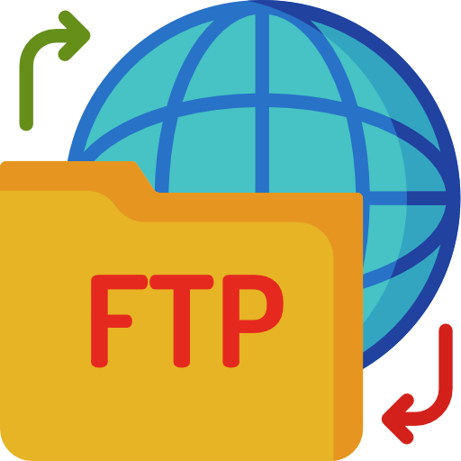

Benefits of Azure Storage
Azure provides top-notch security, as data stored or written in Azure Storage is encrypted. Azure Storage offers full control over who can and cannot access our data
Security
Accessibility
Scalability
High availability

Slide 7


Benefits of Azure Storage
The data stored in Microsoft Azure Storage is made accessible over HTTP or HTTPS from anywhere in the world
Security
Accessibility
Scalability
High availability

Slide 8

Benefits of Azure Storage
Azure Storage is highly scalable in order to meet the on-demand requirements of modern applications
Security
Accessibility
Scalability
High availability

Slide 9


Benefits of Azure Storage
Users are given the option of replicating their data in multiple data centers so that the data stays available even in the event of outages
Security
Accessibility
Scalability
High availability

Slide 10
Introduction to Microsoft Azure Storage

Slide 11
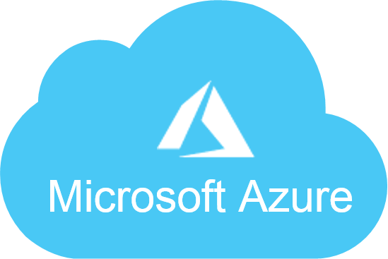

Microsoft Azure Storage
Microsoft Azure Storage is an umbrella term that represents a suite of cloud-based, highly available and durable storage services that are fully managed by Microsoft and is curated for modern data storage scenarios

Slide 12




Microsoft Azure Storage
Microsoft Azure Storage is an umbrella term that represents a suite of cloud-based, highly available and durable storage services that are fully managed by Microsoft and is curated for modern data storage scenarios
This suite of cloud-based Microsoft-managed storage services mainly comprises four types of storage services in Azure:
Azure Blob Storage
Azure Table Storage
Azure Queue Storage
Azure File Storage

Slide 13
Overview of Storage Account

Slide 14


What is Azure Storage Account?
In order to use any type of Azure Storage, you will need to create an account first which is referred to as storage account
Using this account, you will be able to manage and access the storage resources
All your storage data, including blobs, files, queues, and tables, resides in your storage account
The storage account provides a unique namespace for your storage data which will be accessible from anywhere in the world over HTTP and HTTPS

Slide 15
Types of Azure Storage Accounts
General Purpose
Blob Storage

Slide 16
General Purpose Storage Account
Microsoft offers multiple type of storage accounts, each capable of handling different types of storage data.
General Purpose Storage account, as the name suggests, is a storage account that can store any type of storage data in general such as object data, NoSQL, queues or files.
General Purpose Storage Account
Azure Blob
Azure Table
Azure Queue
Azure File

Slide 17
Blob Storage Account
Microsoft offers multiple type of storage accounts, each capable of handling different types of storage data.
As the name suggests, this is "Blob-only" storage account. Blob storage accounts also let you choose the access tier that suits you the best.
Blob Storage Account
Access Tiers
Hot
Cool

Slide 18


Access tier
Access tier is an option provided by Blob storage account that can be used to optimize the costs for using Azure storage based on how frequently the stored data is accessed. The access tier can be changed at any time by the user
Hot
Cool
Hot tier is typically used for storing data that is accessed regularly. This access tier provides low latency, and hence it's comparatively more expensive than cool tier
Cool tier is used to store less accessed data or archived data. Cool tier provides higher latency than hot tier which is why it's best suited for data that is not accessed frequently

Slide 19
Hands-on: Creating a Storage Account

Slide 20
Hands-on: Accessing Storage Account Using Azure Portal

Slide 21
Azure Blob Storage

Slide 22
Why Blob Storage

Slide 23
Why Blob Storage
Blob Storages are usually used to store large Binary Files such as audio, video, text etc.
Can be used to store data for archiving, backups, or restoring
Can be used for serving images or documents directly to a given browser
Can be used for writing log files
Azure Blob

Slide 24
What is Azure Blob Storage

Slide 25
What is Azure Blob Storage
Azure Blob Storage is Microsoft's Object storage solution. Azure Blob is used to store unstructured data which means that it can be used to store data of any format such as document, video files, audio files, and more
Blobs is an abbreviation for Binary Large Objects
Stores data of any format for distributed access
Azure Blob

Slide 26
Hands-on: Create and Configure Azure Blob Storage

Slide 27

Azure File Storage

Slide 28
Why Azure File Storage?

Slide 29


Why Azure File Storage?
Replace or supplement on-premises file servers:
Azure Files can be used to completely replace or supplement traditional on-premises file servers or NAS devices. Popular operating systems such as Windows, macOS, and Linux can directly mount Azure file shares wherever they are in the world. Azure file shares can also be replicated with Azure File Sync to Windows Servers, either on-premises or in the cloud, for performance and distributed caching of the data where it's being used.
Azure File Storage is used when we want to share a common storage mount point among multiple computers

Slide 30

Why Azure File Storage?
We can store configuration files in a centralized location where they can be accessed from many application instances via File Rest API or SMB
Shared application settings
Diagnostic share
Dev./Test/Debug

Slide 31

Why Azure File Storage?
You can have applications store their logs, metrics, and crash dumps in a File Share
Shared application settings
Diagnostic share
Dev./Test/Debug

Slide 32

Why Azure File Storage?
Azure File Storage can be used to store commonly used tools and utilities, which can then be accessed by developers and administrators.
Shared application settings
Diagnostic share
Dev./Test/Debug

Slide 33
What is Azure File Storage?

Slide 34

What is Azure File Storage?
Azure File Storage is a Cloud Service that offers fully managed file shares in the cloud that are accessible via the Server Message Block (SMB) protocol. Azure file shares can be mounted concurrently by cloud or on-premises deployments of Windows, Linux, and macOS

Slide 35
Benefits of Azure File Storage

Slide 36
Benefits of Azure File Storage
Shared access: Since Azure file shares support SMB protocol, you can easily replace your on-premises file shares with Azure file shares
Fully managed: File shares can be created without the need to manage hardware or an OS
Resiliency: Azure files are extremely reliable and fault tolerant

Slide 37
Hands-on: Create Azure File Share

Slide 38
Hands-on: Connect to Azure File Share Using Windows PC

Slide 39
Hands-on: Connect to Azure File Share Using Linux PC

Slide 40

Azure Table Storage

Slide 41
Why Azure Table Storage?

Slide 42
Why Azure Table Storage?
01
Stores Structured NoSQL data in the cloud
02
Fast and cost-effective
03
Can be used to store flexible datasets
04
Can store any number of entities in a table

Slide 43
What is Azure Table Storage?

Slide 44


What is Azure Table Storage?
Azure Table Storage is an Azure Cloud Service that allows you to stores large amounts of structured data in a NoSQL Key Value Store. Azure tables are ideal for storing structured, non-relational data

Slide 45
When to Use Azure Table Storage?

Slide 46

When to Use Azure Table Storage?
Azure Table Storage is used to store large amounts (Terabytes) of data capable of serving web scale applications
Large amount of data
De-normalized data
Fast access

Slide 47

When to Use Azure Table Storage?
Azure Table Storage is used to store datasets that don’t require complex joins, foreign keys, etc.
Large amount of data
De-normalized data
Fast access

Slide 48

When to Use Azure Table Storage?
Azure Table Storage is used in quickly querying data using a clustered index
Large amount of data
De-normalized data
Fast access

Slide 49
Azure Table Storage Concepts

Slide 50
Azure Table Storage Concepts
1
URL format
3
Table
Azure Table Storage accounts use this URL format to be accessed: http://<storage account>.table.core.windows.net/<table>
A table is a collection of entities
5
Properties
A property is a key-value pair that is contained in an entity. Each entity has three system properties, these are: a partition key, a row key, and a timestamp. Entities with the same partition key can be queried more quickly
2
Accounts
4
Entity
All access to Azure Storage is done through a storage account
An entity is a set of properties, like a database row

Slide 51
Azure Table Storage Keys

Slide 52

Azure Table Storage Keys
In Azure Table Storage system, every entity has a primary key. This primary key is a composite primary key that is made up of two parts:
1. Partition key
2. Row key

Slide 53
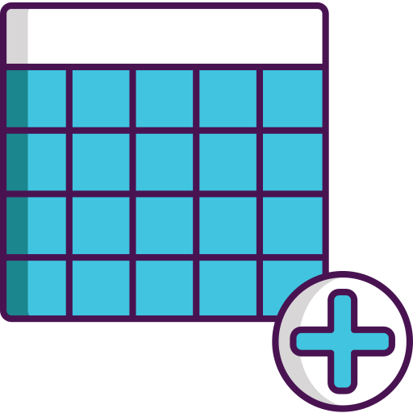
Azure Table Storage Keys
A Partition key is used to partition a table to support load balancing
A Partition key is used to identify the partition that an entity belongs to
Partition key
Row key

Slide 54

Azure Table Storage Keys
A Row key is used to uniquely identify an entity (record) in a given partition
The Partition key and the Row key together form the primary key for the entity
Partition key
Row key

Slide 55
Hands-on: Table Storage

Slide 56
Azure Storage Queue

Slide 57
Why Storage Queues?

Slide 58

Why Storage Queue?
Storage Queues allow us put messages in them so other processes can read and process those messages. For e.g. a message might contain email address of newly signed up user. Other processes can take messages from the queue and send those messages emails.

Slide 59
What are Storage Queues?

Slide 60





What is Azure Queue Storage?
Azure Queue storage is a service for storing large numbers of messages that can be accessed from anywhere in the world

Slide 61
Queue Service Concepts

Slide 62

Queue Service Concepts
3
Queue
1
Accounts
A queue contains a set of messages. The queue name must be in lowercase
All access to Azure Storage is done through a storage account
2
URL format
4
Message
Queues are addressable using the following URL format: https://<storage account>.queue.core.windows.net/<queue>
A message can be in any format and up to 64 KB. The maximum time-to-live allowed can be any positive number, or -1 indicating that the message doesn't expire. The default time-to-live is seven days

Slide 63
Hands-On: Implement Azure Queues

Slide 64

Azure Storage Explorer

Slide 65
What is Azure Storage Explorer?

Slide 66
Why Azure Storage Explorer?
01
Azure Storage Explorer is a standalone app that enables you to easily work with Azure Storage data on Windows, macOS, and Linux
02
It is free to download from Microsoft Website
03
You need to connect to your storage account via Azure Storage Explorer to be able to use it

Slide 67
What can you do with Azure Storage Explorer?

Slide 68
What can you do with Azure Storage Explorer?
Blob storage
View, delete, and copy Blobs and folders
Queue storage
Upload and download Blobs
Table storage
Manage snapshots for Blobs
File storage

Slide 69
What can you do with Azure Storage Explorer?
Blob storage
Peek most recent 32 messages
Queue storage
View, add, and dequeue messages
Table storage
Clear queue
File storage

Slide 70
What can you do with Azure Storage Explorer?
Blob storage
Query entities with OData or query builder
Queue storage
Add, edit, and delete entities
Table storage
Import and export tables and query results
File storage

Slide 71
What can you do with Azure Storage Explorer?
Blob storage
Navigate files through directories
Queue storage
Upload, download, delete, and copy files and directories
Table storage
View and edit file properties
File storage

Slide 72
Hands-On: Attach or Detach an External Storage Account

Slide 73
Hands-On: Access and Manage Azure Storage Services using Storage Explorer

Slide 74
Azure Shared Access Signature

Slide 75
Why Shared Access Signature?

Slide 76




Why Shared Access Signature?
A shared access signature (SAS) is a token that grants restricted access rights to Azure Storage resources. With SAS, we can grant clients access to resources in our storage account, without sharing our account keys
Granting Access to clients
Using SAS
Clients Accessing
Resource Groups in
Storage Account

Slide 77
What is SAS in Blob Storage

Slide 78
Shared Access Signature
A shared access signature (SAS) is a secure token that allows you to specify the time span and permissions allowed for access to a storage resource such as a blob or container.
If you wish to grant someone access to a storage resource for a specified time you can generate an SAS token that the person or application will need to provide to gain access to the specified resource within the specified time.

Slide 79
Demo: Use of SAS in Blob Storage

Slide 80
Azure Storage Replication

Slide 81
Why Azure Storage Replication?

Slide 82

Why Azure Storage Replication?
Storage Replication ensures that you always have access to your data stored on Azure Storage even in the face of failures. Replication is how Azure Storage guarantees durability and availability

Slide 83
What is Azure Storage Replication?

Slide 84
What is Azure Storage Replication?
The data in your Microsoft Azure Storage account is always replicated to ensure durability and high availability
Azure Storage copies your data so that it is protected from planned and unplanned events, including hardware failures, network or power outages, and massive natural disasters
You can choose to replicate your data within the same data center, across zonal data centers within the same region, or across geographically separated regions

Slide 85
Data Replication Options

Slide 86

Data Replication Options
Locally redundant storage (LRS)
Replicates three copies of your data within the same data center where you have your data
Zone-redundant storage (ZRS)
Geo-redundant storage (GRS)
Read-access geo-redundant storage (RA-GRS)

Slide 87

Data Replication Options
Locally redundant storage (LRS)
Replicates your data synchronously across three storage clusters in a single region
Zone-redundant storage (ZRS)
Geo-redundant storage (GRS)
Read-access geo-redundant storage (RA-GRS)

Slide 88

Data Replication Options
Locally redundant storage (LRS)
Replicates your data to a secondary region that is hundreds of miles away from the primary region
Zone-redundant storage (ZRS)
Geo-redundant storage (GRS)
Read-access geo-redundant storage (RA-GRS)

Slide 89

Data Replication Options
Locally redundant storage (LRS)
Provides read-only access to the data in the secondary location
Zone-redundant storage (ZRS)
Geo-redundant storage (GRS)
Read-access geo-redundant storage (RA-GRS)

Slide 90
Azure Import/Export Service

Slide 91
Why Azure Import/Export service?

Slide 92

Why Azure Import/Export service?
Transferring the data over the Internet can take days, weeks, or even months. To avoid this issue, Microsoft provides the Import/Export service where you ship your physical disks directly to Azure data center, and they will upload them for you

Slide 93
What is Azure Import/Export service?

Slide 94
What is Azure Import/Export Service?
Azure Import/Export service is used to securely import large amounts of data to Azure Blob Storage and Azure Files by shipping disk drives to an Azure data center
This service can also be used to transfer data from Azure Blob Storage to disk drives and ship to your on-premises sites
Data from one or more disk drives can be imported either to Azure Blob Storage or Azure Files
Supply your own disk drives and transfer data with the Azure Import/Export service. You can also use disk drives supplied by Microsoft

Slide 95
Azure Import/Export Use Cases

Slide 96

Azure Import/Export Use Cases
Data migration to the cloud
Move large amounts of data to Azure quickly and cost effectively
Content distribution
Backup
Data recovery

Slide 97

Azure Import/Export Use Cases
Data migration to the cloud
Quickly send data to your customer sites
Content distribution
Backup
Data recovery

Slide 98

Azure Import/Export Use Cases
Data migration to the cloud
Take backups of your on-premises data to store in Azure Storage
Content distribution
Backup
Data recovery

Slide 99

Azure Import/Export Use Cases
Data migration to the cloud
Recover large amounts of data stored in storage and have it delivered to your on-premises location
Content distribution
Backup
Data recovery

Slide 100
Azure Import Export Job Flow

Slide 101







Azure Import Export Job Flow
Shipping
3. Ship the hard drives to Microsoft Data Center.
4. The Carrier Delivers the hard drive to the data center.
Creating
1. Prepare the Hard Drive using Import / Export Client Tool and Encrypt the drive with Bit Locker
2. Create an Import Export Job using Azure Portal
Transferring
5. Hard Drives are processed at the data centers.
6. Data is copied from Hard Drive to Storage Account.
Complete
8. Hard Drives are shipped back to the customer.
Packaging
7. Hard Drives are packages for return shipping.

Slide 102
Azure File Sync

Slide 103
Why Azure File Sync?

Slide 104

Why Azure File Sync?
Azure File Sync allows the synchronization of on-premises file servers with Azure Files supported by Storage Accounts

Slide 105
What is Azure File Sync?

Slide 106
What is Azure File Sync?
Azure File Sync provides on-premises users and applications with quicker access to cloud files
Azure File Sync is powered by local caches and continually synchronizes with Windows Server
This helps organizations with multiple sites to centralize their files onto a single shared server or VM

Slide 107

Azure Blob Storage Backup

Slide 108
Azure Blob Storage Backup

Slide 109

Azure Blob Storage Backup
The Azure Backup service backs up data to the Microsoft Azure cloud. Data can be backed up and recovered at a granular level, including backup of files and folders

Slide 110
Azure Blob Storage Backup Options

Slide 111

Azure Blob Storage Backup options
AZ Copy
You can copy Blobs to a second storage account using the AZ Copy
Snapshots
Azure archive storage

Slide 112

Azure Blob Storage Backup options
AZ Copy
Blob storage can create snapshots. These are snapshots of individual blobs, not the whole account. They exist only in the storage account, and you cannot store them in a vault
Snapshots
Azure archive storage

Slide 113

Azure Blob Storage Backup options
AZ Copy
It is used mostly to store data that is used quite rarely. It is the lowest-priced storage tier. Data at rest is automatically encrypted
Snapshots
Azure archive storage

Slide 114
Hands-on: Implement Azure Backup Service

Slide 115
Azure CDN

Slide 116
Why CDN?

Slide 117

Why CDN?
Content Delivery Network (CDN) provides alternative server nodes for users to download resources (usually static content like images). These nodes are spread throughout the world

Slide 118
What is Azure CDN?

Slide 119
What is Azure CDN?
01
Azure CDN is a global CDN solution for delivering high-bandwidth content
02
You can cache static objects loaded from Azure Blob storage by using the closest point of presence (POP) server
03
Azure CDN can also accelerate dynamic content, which cannot be cached, by leveraging various network and routing optimizations

Slide 120
Hands-on: Implement Azure CDN

Slide 121

Quiz
1. Which of these storage services can you mount on as a drive on your desktop?
A. Blob Storage
B. File Storage
C. Table Storage
D. Queue Storage

Slide 122
Quiz
2. Which of the following access tiers should be used for low latency access?
A. Hot
B. Cool
C. Archived
D. All of the above

Slide 123
Quiz
3. Which of these storage services is used to store structured data?
A. Blob Storage
B. File Storage
C. Table Storage
D. Queue Storage

Slide 124
Quiz
4. Which of the following is a type of key used by Azure Table Storage?
A. Partition Key
B. Sample Key
C. Cluster Key
D. Storage Key

Slide 125
Quiz
5. Azure file sync can work with both windows and ubuntu server.
A. True
B. False

Slide 126

India: +91-7847955955
US: 1-800-216-8930 (TOLL FREE)
support@intellipaat.com
24/7 Chat with Our Course Advisor

